Slide 1
NAME : MONISH RAJ S
REG.NO : 312211645
DEPARTMENT: 3 BCOM GENERAL A SECTION
COLLEGE : THIRUTHANGAL NADAR COLLEGE

Slide 2
Topic
Data Manipulation Techniques, Conditional Formatting, Pivot Table, Functions and Formulas, Power Query, Charts and Graphs

Slide 3
AGENDA
Identifying False Statement
Setting an Agenda
Data Modeling
Describing the Data
Result Analysis
Conclusions
Thank you

Slide 4
Identifying False Statements
Importance of detecting false or misleading statements in data.
Common signs of false data: inconsistencies, lack of source transparency, too good to be true results.
Techniques: Cross-referencing data, using statistical tests to check validity.

Slide 5
Setting an Agenda
Defining the purpose and goals of the analysis.
Prioritizing key questions and determining the scope of the project.
Example: Setting an agenda for analyzing sales trends to inform marketing s

Slide 6
Data modeling
The role of models in data analysis: simplifying reality to understand complex systems.
Types of models: Descriptive, predictive, prescriptive.
Example: Using regression analysis to predict future sales based on historical data.

Slide 7
Describing the Data
Descriptive statistics: mean, median, mode, standard deviation.
Visualizing data: histograms, box plots, scatter plots.
Example: Describing customer demographics before running a marketing campaign.

Slide 8
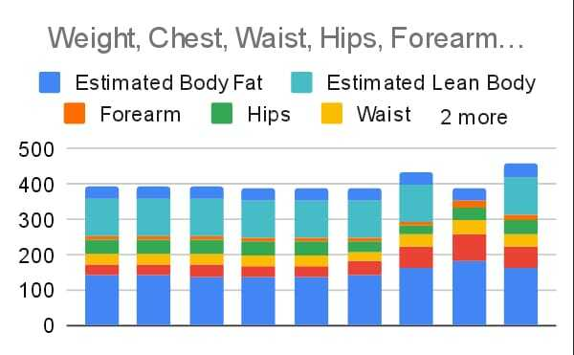
RESULT ANALYSIS

Slide 9
Graph analysis
The stacked bar chart shows the distribution of various body measurements over time. It reveals that overall measurements remain stable, with body fat being the largest component in each period. This chart effectively tracks changes in body composition.

Slide 10
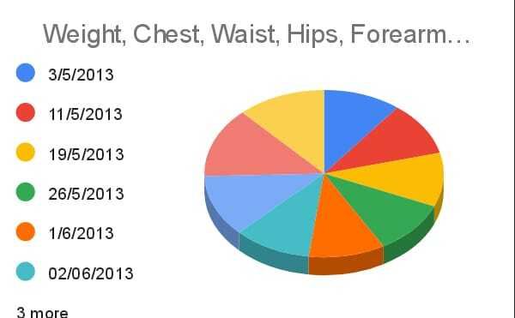

Slide 11
Pie chart analysis
Consistency: If slices are similar in size, measurements have remained stable over time.
Significant Changes: Larger or smaller slices suggest notable changes in measurements on those dates.
Visualization: A line or bar chart might offer clearer insights into trends over time.

Slide 12
Conclusion
The pie chart gives a quick snapshot of how measurements compare across different dates but may not be the best tool for detailed analysis. A more precise method (like a time series line graph) could provide better insights into how these measurements have evolved, making it easier to identify trends, outliers, and areas for improvement.

Slide 13


